Slide 1
RANDIMA HATALULI 219017847 CSC3A MINI PROJECT
CONNECTING STUDENTS BASED ON SAME QUALITIES

Slide 2

PRESENTATION CONTENT
The Presentation will cover :
Problem Statement
Proposed Solutions
Solutions (High level description)
Edges
Vertices
Screenshots of Implementation

Slide 3
PROBLEM STATEMENT
Users(Students) struggles to get connected to other students which they share similar qualities and those other people appears on suggestion page.
When they came across with some difficulties they cant get help from people of same level(qualities)(Courses and level of study) and with those who stays near them through their location .
This will have probability of connection with students of same level and those who always online because will be them that can be helpful very fast and students can connect to lots of other students through them.
Users may be wondering what's happening with the connections they had with other students because when they check its decreasing and they are not being informed something like notification if others has willingly removes their connection.

Slide 4
Proposed Solutions
The solution is to have a system that allows users(student) who you have common qualities (same course and same level of study (undergrad or postgrad) with them to appear on suggestion list .
Who are mostly always online in the platform and they will be able to see their location. This way you can get connected to other students and have relationship with them then you will get help on them. It will only allow you to connect to other students if you share same qualities.
Students will be able to remove their connection with others and in other hand students will be able to see when other students they are removing their connection with them (by showing an alert message).

Slide 5
High level proposed solutions
System will capture student details which can be Name, Course name, university name, year they are doing, and their location (in X and Y coordinates).
Student can be able to update their details through the system and can see the details of other students.
For the connection between vertices (Undergrad and Postgrad student versa versa) it will require them to input the distance between them and the connection will only happen if share same qualities and same level of study.
Based on the information provided, a graph will be drawn to then show the relationship those respective (Undergrad and Postgrad student versa versa).
Students can remove their connection with another student and can permanently delete other student.

Slide 6
Vertices and edges
Vertices store Undergraduate( ) and postgraduate( ) student.
Edges are going to be the location coordinates that are going to then determine the distance between students.

Slide 7
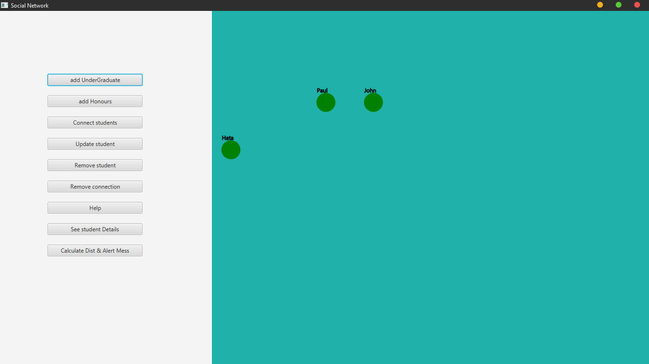
initial START WITH STUDENT ONLINE AND SUGESTED

Slide 8
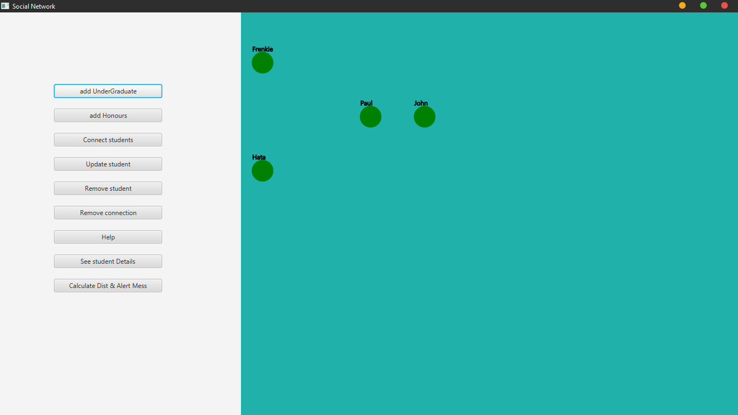
ADDING UNDERGRADUATE STUDENT

Slide 9
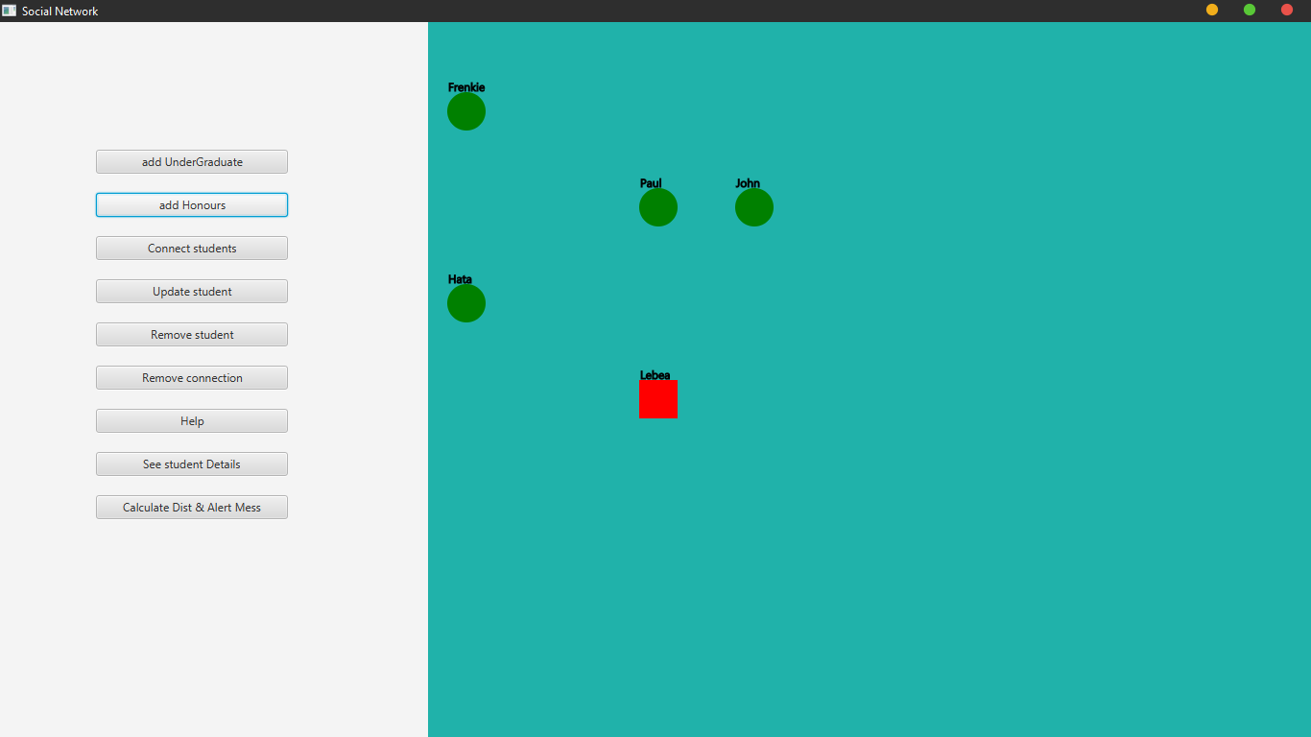
ADDING Postgrad STUDENT

Slide 10
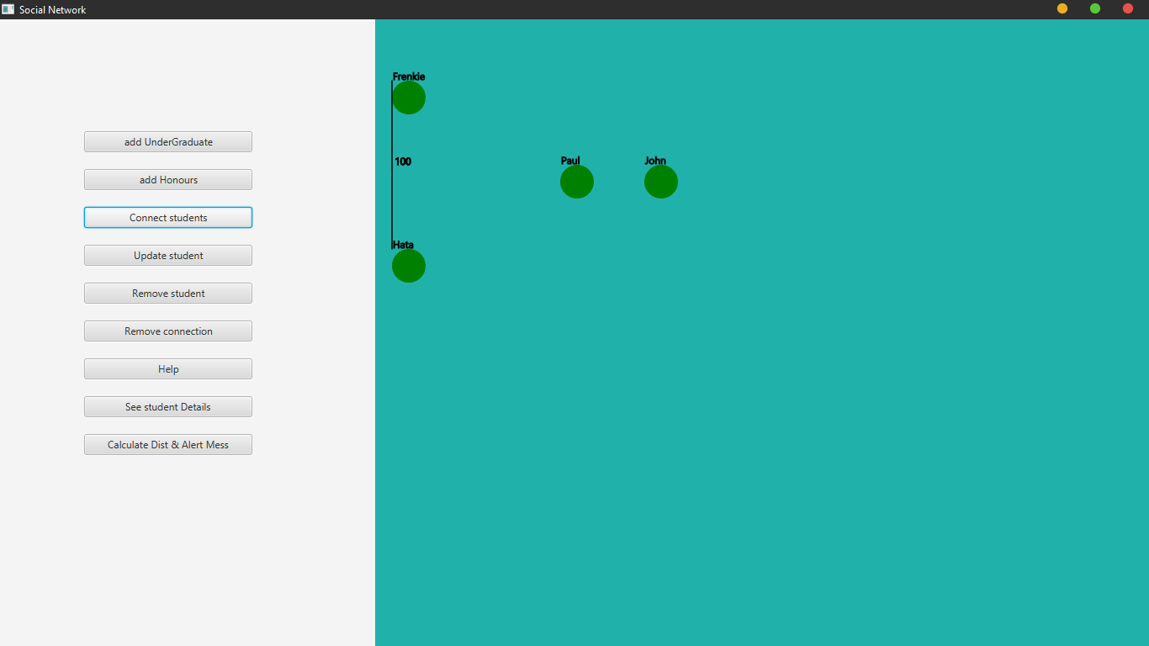
CONNECTION UNDERGRAD STUDENTS

Slide 11
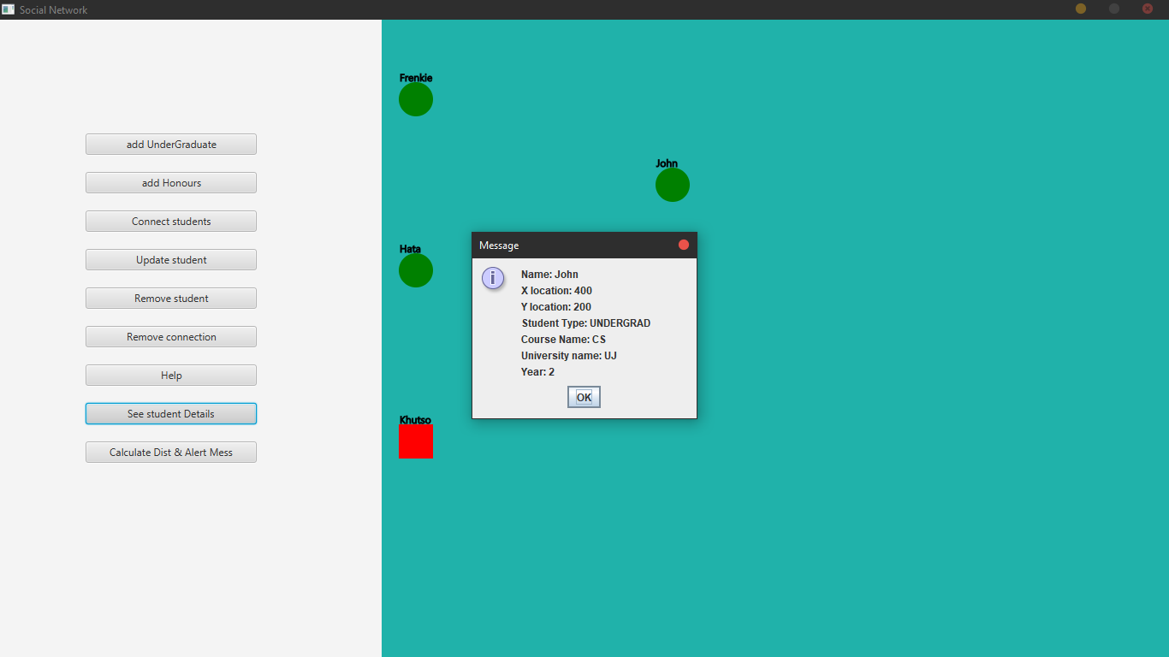
SEE STUDENT DETAILS

Slide 12
Other operation to BE demonstrated

